Slide 1
Finalizing a Data Science Project
Communicate Results to Stakeholders
Demonstrate Models in a Web App
Implement and Test Production Pipelines

Slide 2

Communicate Results to Stakeholders

Slide 3






You Are Here (Finalize)
Frame the Problem
Identify & Collect Data
Process Data
Analyze Data
Finalize the Project
Train Models

Slide 4

Know Your Audience
Your audience might be:
Just you, no reporting needed
A single person
A small group of stakeholders
An entire organization
You may need to adjust your reporting for:
Different knowledge
Different needs
Different expectations

Slide 5
Derive Insights from Findings
Findings must be translated into business insights to demonstrate their value.
Begin by reviewing the overall process and results.
Ask yourself:
What did I know before the project?
What do I know now?
How does my analysis supplement my knowledge?
How do the models I built address issues?
How do the results align with KPIs?
What business actions can be taken?
How can I improve the data science process in the future?
Ensure insights are both relevant and in context.
E.g., customers care less about insights into increasing profits than insights into improving the user experience.
Ensure insights are clear and precise.
E.g., a classifier "is 95% accurate and will save 20 work hours in a week as compared to current manual review."

Slide 6
Explainability
Explainability/interpretability is one factor that drives your conclusions.
An explainable process is one whose inner workings are identifiable and can be communicated.
Often, you must be able to explain why a model produced a result.
Proves model's skill.
Makes decisions more defensible.
Allays concerns people have for automation.
Some algorithms are "black boxes" and can't be easily interpreted.
E.g., neural networks.
Many algorithms are explainable, however.
There are several ways to explain them.

Slide 7
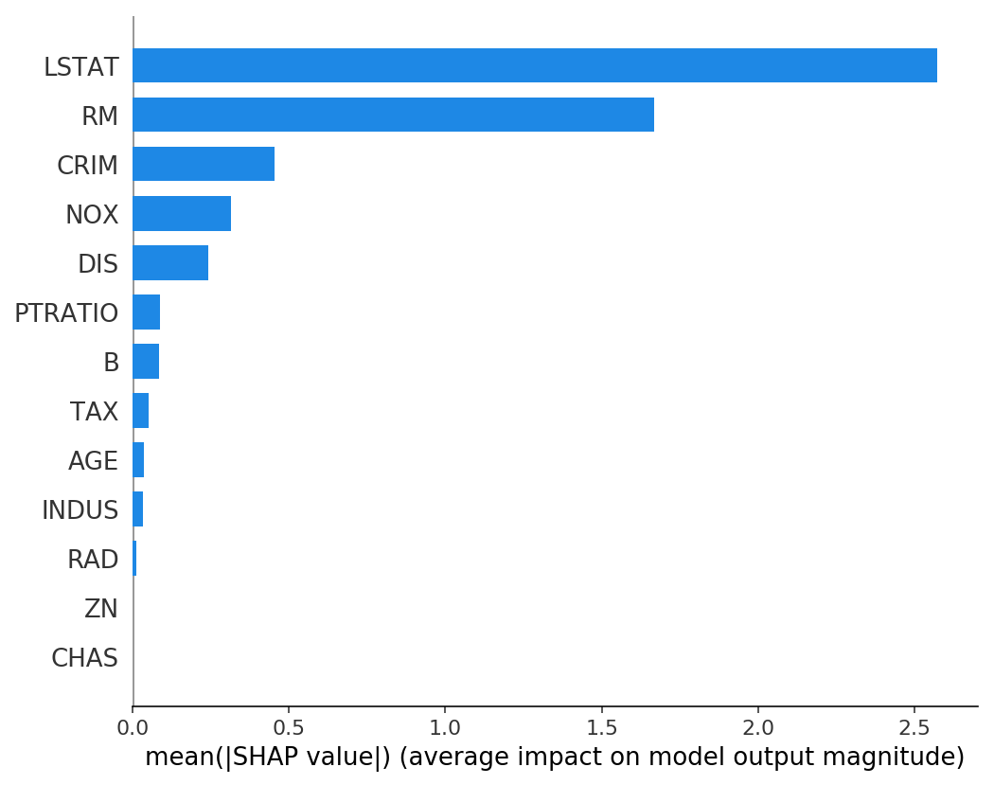
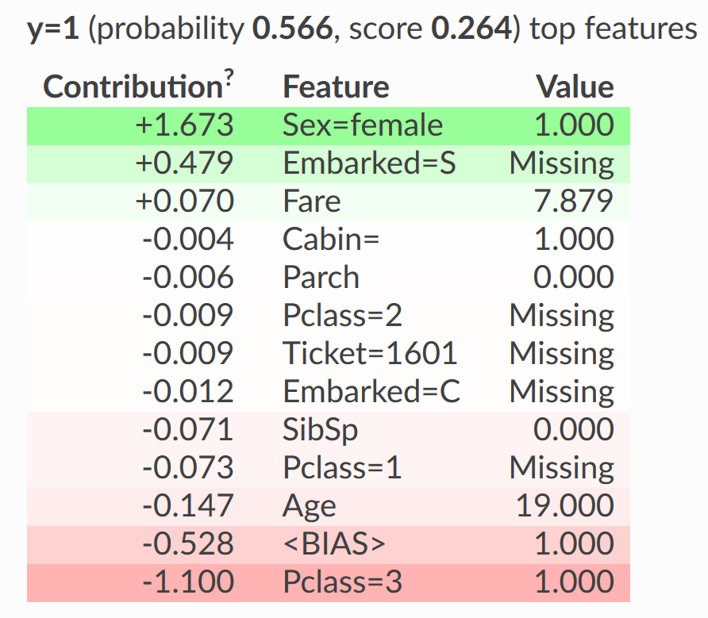
Global vs. Local Interpretability
SHAP (Global)
ELI5 (Local)
% low-income households
Number of rooms

Slide 8
Additional Factors That Drive Outcomes
Examples:
Accountability
Safety and security
Fairness and non-discrimination
Time and resources
Review your own project for any other potential factors.
Identifying factors will better prepare you to communicate outcomes to stakeholders.

Slide 9
Present Model Results
An executive summary or abstract of the project.
Captures high-level points.
The business issue you set out to address.
Describe problem and identify solution.
The data.
What data was used and where it came from.
The hypothesis.
How solution evolved based on initial analysis.
The solution.
Identify what was revealed and its business implications.

Slide 10
Use Visuals in Presentations (Slide 1 of 2)
Visuals can be used for presentation, not just analysis.
Powerful means of conveying patterns to an audience.
Some chart types are more suited to non-technical audiences.
Bar, line, etc.
Some are more difficult to interpret.
Heatmap, pair plots, etc.
Type and quantity of information can also affect interpretability.
Visuals should be simple, yet impart important ideas and/or tell a good story.
Also be sure to:
Label axes and chart titles.
Label ticks as needed without overwhelming the plot.
Use legends as needed to help identification.
Not rely solely on color coding, but at least consider people with color blindness.
Avoid unnecessary details or decoration.

Slide 11
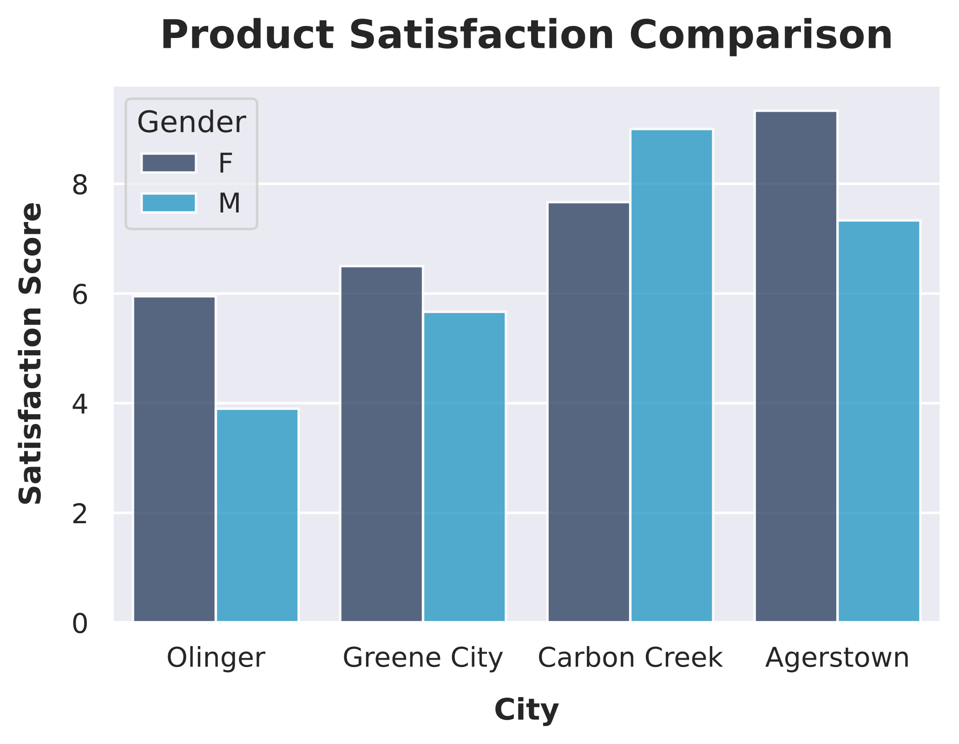
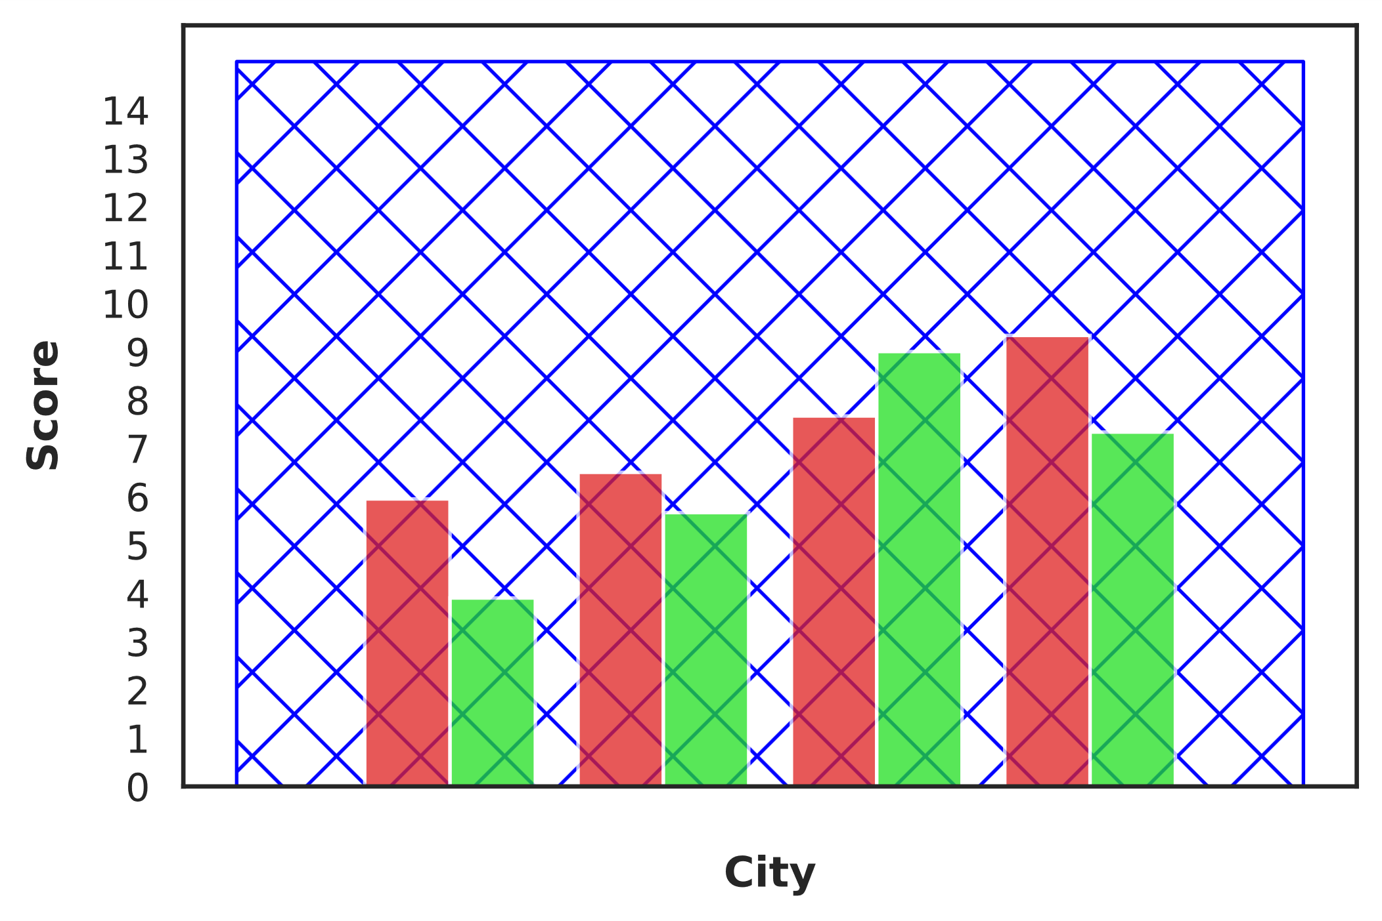
Use Visuals in Presentations (Slide 2 of 2)
Unhelpful
Helpful

Slide 12
Dashboards (Slide 1 of 2)
Dashboard: A high-level visualization tool that summarizes the status of an entire project or one or more parts of a project.
Used by stakeholders to view project progress at a quick glance.
Also used by practitioners to get a performance overview.
Give pertinent information up front.
Can be viewed on a rolling basis, not just at the end of a project.
Structure is based on KPIs:
Size of data
Model training time
Computation price
Model metrics
Model parameter complexity
KPIs visualized using charts, graphs, tables, etc.
Arranged on a single screen; no need to flip between pages.
Similar elements are grouped together.

Slide 13
Dashboards (Slide 2 of 2)
Image Classifier
Current Status
Accuracy Metric
Status | Value
Dataset size | 13,398
Last epoch training time | 5 hours, 32 minutes
Elastic compute cost | $453.09
95
85
Accuracy
Metric | Value
Accuracy | 93.45%
Recall | 67.23%
Precision | 75.21%
75
1
2
3
4
5
Training Epoch

Slide 14
Cumulative Gains Charts
100
90
Offering credit to top 20% will be received by 50% of returning customers
80
70
60
50
Gain (%)
40
30
20
Model
10
Null hypothesis
Baseline
0
0 10 20 30 40 50 60 70 80 90 100
% of Total Customers

Slide 15
Lift Charts
3.0
Offering credit to top 20% will be received by 2.5x as many returning customers
2.5
2.0
Lift
1.5
1.0
0.5
Null hypothesis
Model
Baseline
0.0
0 10 20 30 40 50 60 70 80 90 100
% of Total Customers

Slide 16
Guidelines for Communicating Results to Stakeholders
Don't drown your audience in a sea of numbers.
Use visuals strategically.
Use formatting, labels, and legends.
Avoid suspense.
Provide context for details.
Be honest and transparent.
Identify key assumptions you have made.
Check your work.
Invite feedback.
Provide supplementary channels for those with different communication styles.
Provide supplementary documentation for those with different informational needs.
Test it before you deliver it.

Slide 17
Communicating Results to Stakeholders

Slide 18
Demonstrate Models in a Web App

Slide 19
Web App (Slide 1 of 2)
Web app: An app that runs on a server using HTTP/S.
Client browsers make requests of web servers, which respond.
Often used to demonstrate results of data science project.
E.g., a POC or a final presentation.
More robust than traditional presentation methods like slide shows.
Can dynamically accept input and make changes.
E.g., users can change time scale of forecasting visual.
Input is done through menus, buttons, text fields, etc.
Makes it easier for audience to get what they're looking for.
Consider how your demonstration might be better delivered as a web app.
More complicated and requires more time and effort.
Requires specialized expertise.

Slide 20
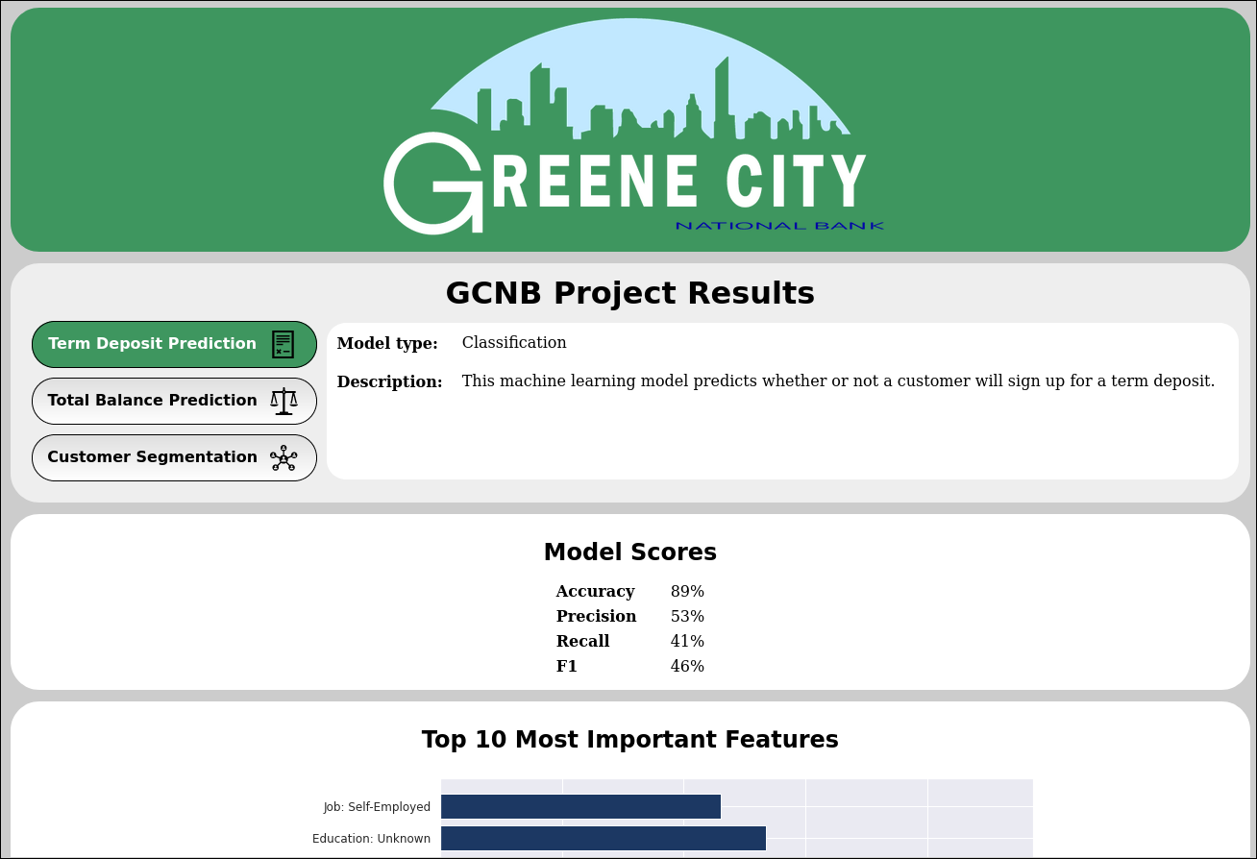
Web App (Slide 2 of 2)

Slide 21
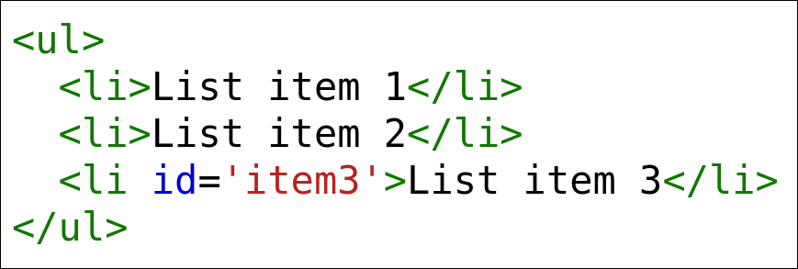
HTML
Hypertext Markup Language: The primary markup language used to develop web page content.
Web pages are composed of HTML elements.
Handles both content and page structure.
Lenient when it comes to errors.
HTML is foundational to web apps.
Ensure you're familiar with its syntax and common elements/attributes.
Example of nesting page elements through opening and closing tags:

Slide 22

CSS
Cascading Style Sheets: A set of rules that define the appearance of web content.
Includes how page elements are colored, how text is aligned, and much more.
Separates web content (HTML) from presentation style (CSS).
Distinguishes functionality, making it more manageable.
Doing styles through HTML only is tedious and messy.
Style sheets are text files that specify how HTML elements are displayed.
HTML file references sheets.
Syntax for making text in all list items blue:
Prevents you from needing to format each element separately.
Makes demonstrations more visually appealing.

Slide 23
JavaScript
JavaScript: A scripting language that provides interactive functionality to a web app.
Tells browser how to change in response to an event, like user input.
Significant component to the dynamic web.
Syntax can use multiple paradigms, include object-oriented programming.
Example of a button that changes the text of the third unordered list item:
<button> is HTML element.
onclick is an attribute.
getElementById() is a method that gets the list item's contents.
innerHTML is a property that sets the text when button is pressed.
"Listen item 3" becomes "Listen item changed!"
JavaScript adds an extra level of interactivity to demonstrations.

Slide 24
Web Frameworks
Web framework: A programming library that supports the development of web apps through a standardized interface.
Alleviates effort of writing functionality from scratch using HTML.
The more dynamic an app is, the more tedious it is to write.
Provides functions developer can use to automate/streamline process.
App requires less effort to build and can be highly interactive.
Highly popular among developers of dynamic apps.
Implemented in specific languages.
E.g., Ruby on Rails won't work with Python.
Most frameworks provide common features like:
HTML template generation
Input validation
Defense against web-based attacks
Database connection/configuration
Session management

Slide 25
Common Web Frameworks
Language | Web Frameworks
Python | Flask Django web2py
Ruby | Ruby on Rails Sinatra Padrino
PHP | Laravel Symfony CodeIgniter
Java | Spring Framework Apache Struts Grails
JavaScript | AngularJS Express Meteor

Slide 26
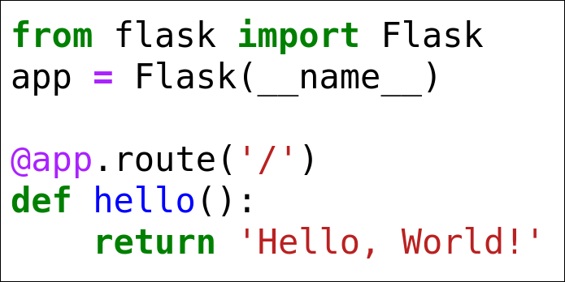
Flask
Flask: A lightweight web framework for Python.
Most features are added through third-party extensions, not built in.
Extensions available on PyPI.
Extensions for database connections, graphing, RESTful services, and many more.
Flask is simple to set up and easy to use.
Commonly used by new web developers.
Example app:
Experienced developers can leverage Flask to build small, single-purpose apps.
Flask can adapt to ever-changing apps.

Slide 27
Django (Slide 1 of 2)
Django: A fully featured web framework for Python.
Unlike Flask, Django has a robust toolkit with most features built in.
Django setup is more involved and time consuming.
Advantages:
Once setup is complete, development in Django can proceed quickly.
Django is versatile.
Django projects can be split into multiple apps.
Django is best for large, complex projects with many features.
Many developers start with Flask, then migrate to Django.
For data science projects:
Flask usually suffices for most demonstrative web apps.
Django is preferred for more complex presentations to wider audiences.

Slide 28
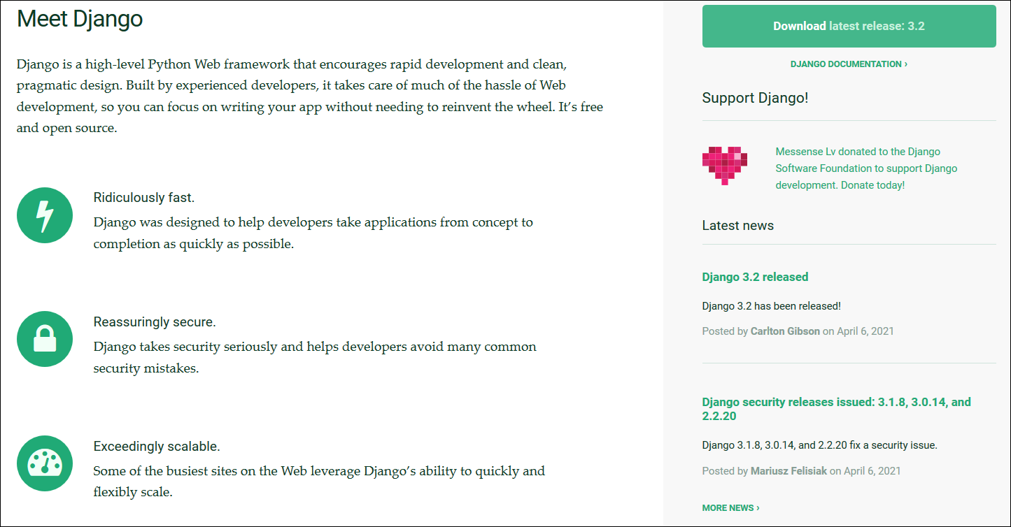
Django (Slide 2 of 2)

Slide 29
Guidelines for Demonstrating Models in a Web App
Start small and simple, using an iterative approach to refine a web app.
Be aware that web apps can be complicated to create and maintain.
Consider engaging an IT or development organization to assist with web app design.
Use a built-in utility or application to display results, conclusions, and charts, if provided.
Consider prototyping a solution with a small group before it is enabled for everyone.
Remember to tell a story with the data.
Focus more on the information being presented than fancy features.
Consider where a web app will be deployed based on the availability required.
Be aware of security issues for your web app.

Slide 30
Demonstrating Models in a Web App

Slide 31
Implement and Test Production Pipelines

Slide 32
Put a Model into Production
After development is done and solution has been accepted, the model must be deployed to production.
Some models represent a larger prototype, rather than just a one-time answer.
Models rolled into existing products/processes.
Models incorporated into solutions still in development.
Consider how to deploy model on a platform that may have different code.
You may hand off code to other software developers.
Model must be tested and maintained over time.
Answer questions such as:
Should a data pipeline be constructed to support the model?
How can the solution address needs of scale and growth?
How should the system be maintained?

Slide 33
Data Pipelines
Data pipeline: A sequential set of processes that automate the data science process by chaining tasks together.
The output of one phase can flow into the input of another phase.
E.g., data is ingested, cleaned, analyzed, modeled, and deployed as a series of steps.
Makes your job easier by automating repetitive tasks.
More time to focus on tasks requiring human judgment.
Examples of automation at each step of the data science process:
Problem formulation—machine learning can identify areas of improvement.
Data collection—endpoints can ingest data automatically from external resources.
Data processing—issues with data can be identified and corrected automatically.
Data analysis—visuals and other analysis outputs can be constructed automatically.
Model training—the training/tuning process is repeatable.
Project finalization—pipeline can load new data into a presentation automatically.
Identify models in deployment as being offline or online.
Offline models train on historical data and are static.
Online models continuously train on new data and are dynamic.

Slide 34
Model Drift (Slide 1 of 2)
Model drift: A process through which a model's effectiveness decays over time due to changing factors in the problem domain.
Affects some domains more than others.
Example: Model predicts behavior of online shoppers.
How they respond to advertising, coupons, etc.
Behaviors change over time.
A website may see decreased traffic, so ads are less effective.
Model's skill decays since it can't keep up with changing factors.
Online models can help mitigate drift.
Model's domain knowledge is kept up to date.
Model's assumptions are also up to date.
E.g., continuously track customer behavior and feed that data into a pipeline.
New model is produced that can make decisions based on current data.
Online models are difficult to implement.
Require constant ingest of new data.
Take up a lot of time and resources going through the training process.

Slide 35
Model Drift (Slide 2 of 2)
Model Updated
Model Not Updated
Model Skill
Time

Slide 36
Docker (Slide 1 of 2)
Docker: An open source platform for building and maintaining virtual containers.
Containers run apps without disrupting host environment.
Containers share resources with underlying host OS.
Don't virtualize an entire OS like a VM.
Are isolated from OS and other containers.
Containers are faster, more lightweight, and more portable than VMs.
Containers built for one OS don't always work for another OS.
Docker is most popular containerization software.
Docker Desktop is main GUI for managing containers.
Docker Hub is main repo for pulling/pushing container images.
Docker facilitates pipelining.
Can create separate container for each step in the process.
Outputs flow from one container to next.
You can configure each task without disrupting others.
You can share containers with colleagues.

Slide 37
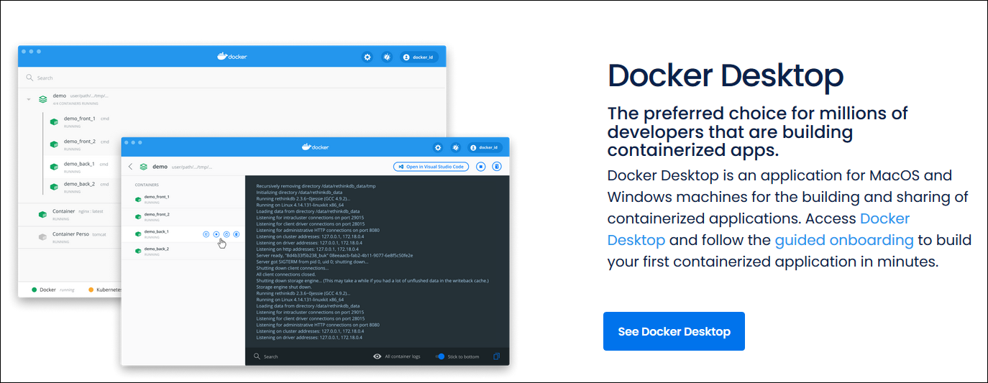
Docker (Slide 2 of 2)

Slide 38
Kubernetes (Slide 1 of 2)
Kubernetes: An open source platform for orchestrating the deployment and management of virtual containers.
Automates container-related tasks.
Helps organizations scale container environments.
Uses computer clusters.
Group of hosts working together as one.
Run an infrastructure of containers on multiple physical or virtual machines.
Simulates deployment at certain scales.
Leverages hardware for resource-intensive projects.
Can span cloud and on-premises locations.
Supports multiple containerization platforms, particularly Docker.
Consider using if setting up/maintaining Docker containers is tedious.
Consider using if you have large-scale data or deployment needs.

Slide 39
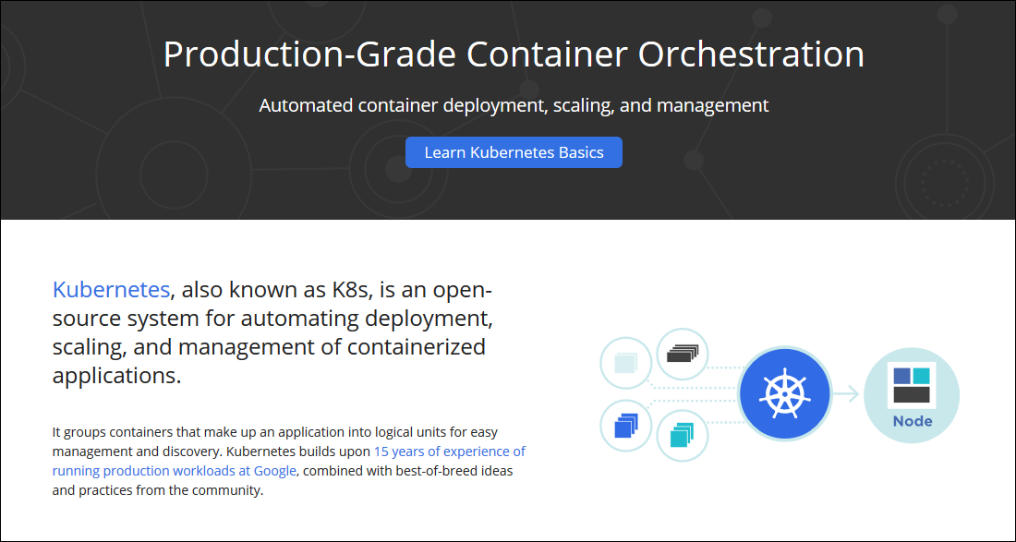
Kubernetes (Slide 2 of 2)

Slide 40
Amazon SageMaker (Slide 1 of 2)
Amazon SageMaker: A cloud machine learning service that is part of Amazon Web Services (AWS).
Facilitates each step of the data science process.
From collecting and preparing data to deploying models.
Has many individual services that can contribute to an overall pipeline.
E.g., SageMaker Ground Truth automates data labeling.
E.g., SageMaker Clarify automatically detects bias.
Integrate with common data science languages and frameworks.
Includes pre-built templates and solutions.
E.g., SageMaker JumpStart provides pre-trained models to save time.
SageMaker also supports Kubernetes orchestration.
SageMaker Pipelines is a custom-built orchestration service.
Organizations rely on cloud services like this because of their scalability.
Amazon has access to resources most don't.
Can be practical and cost-effective to rely on the cloud.

Slide 41
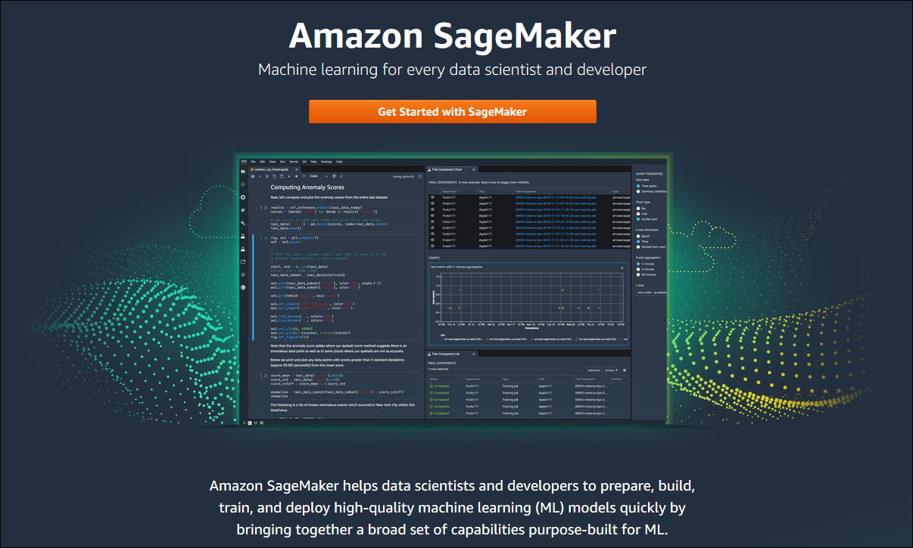
Amazon SageMaker (Slide 2 of 2)

Slide 42
Azure Machine Learning (Slide 1 of 2)
Azure Machine Learning: A cloud-based machine learning service offered as part of Microsoft Azure.
Includes many tools and solutions that can be part of an overall pipeline.
Streamline data preparation, train on pre-configured algorithms, deploy to endpoints, etc.
Also support common languages/frameworks.
Emphasizes MLOps.
Marriage of machine learning and traditional IT operations, like DevOps.
Enables tracking of data.
Supports data governance for meeting business needs and requirements.
There is not necessarily one best option for cloud-based data automation.
Research them with your team.
Determine which ones meet your needs the best.

Slide 43
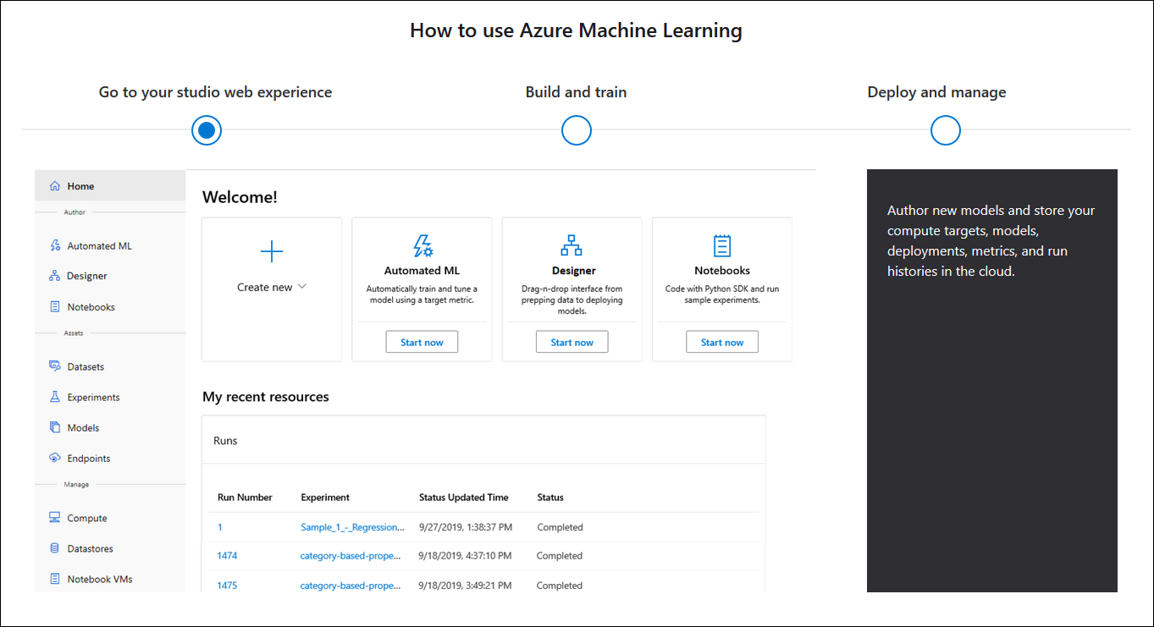
Azure Machine Learning (Slide 2 of 2)

Slide 44
Monitor Models in Production
One benefit of a pipeline is monitoring project tasks.
You want to avoid situations where you get unexpected outputs.
E.g., model failure, model performance degradation, leaking data, etc.
Catching problems early can save you time and effort.
Monitoring is therefore crucial.
Monitoring can take many forms.
E.g., log each epoch of training to determine if training is on schedule.
E.g., dashboard of training metrics to identify skill improvement or degradation.
You can monitor at many levels of granularity.

Slide 45
Pipeline Monitoring Solutions
Solution | Description
Kubeflow | Orchestrates data science/ML pipelines that run with Kubernetes. Has dashboards for monitoring clusters and recent tasks. Logs model metrics. Supports third-party monitoring tool Prometheus.
MLflow | Open source data automation platform that's part of Linux Foundation. MLflow Tracking logs parameters, model metrics, file outputs, etc. Has APIs for Python, R, Java, and RESTful services. Has a GUI version.
Datadog | General platform for monitoring cloud services. Integrates with many services from many providers. Consolidates app data and logs into a single monitoring platform. Provides interactive dashboards and alert functionality.

Slide 46
Guidelines for Implementing and Testing Production Pipelines
Create unit tests that validate the model every time new code is pushed out to the application.
Protect the model from upstream changes to the data pipeline.
Protect downstream consumers of the model.
Design for periodic retraining of the model.
Provide a versioning system for various components used in the application.
Put appropriate protections in place for the data pipeline and all outputs.

Slide 47
Building an ML Pipeline

Slide 48
In your data science projects, to whom will you typically have to present your findings?
What form will your presentations most likely take?

